Slide 1



Slide 2
Lessons from the Super Rich
Net worth of Super Rich: $500 million or more.
Following in the path of the Super Rich can help you avoid costly and painful errors.
When it comes to business and financial success, learning the lessons of the Super Rich can help you get the results you want.

Slide 3
Elite Wealth Planning
Technical expertise
    Extensive range of legal and financial strategies
    From the basic to state-of-the-art
The human element
    The personal and emotional component of elite wealth planning
No longer restricted to the Super Rich
    Regulatory and tax law changes
    Technology

Slide 4
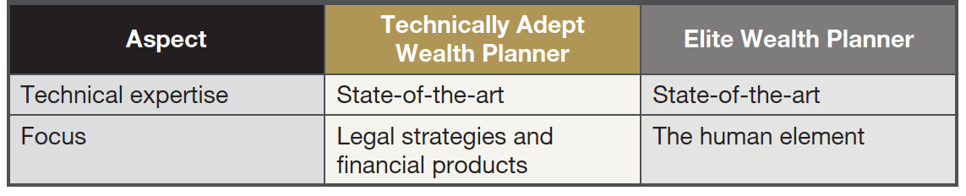
Comparing Wealth Planners and
Elite Wealth Planners

Slide 5
Planning Specialties
Estate planning
Income tax planning
Marital and related relations planning
Business succession planning
Asset protection planning
Charitable tax planning
Cross-border and inbound planning
Life management planning

Slide 6
Estate Planning
Using legal structures and financial products to determine the future disposition of current and projected assets
The human element
    Primary driver.
    Structures (such as trusts, partnerships and financial products)
    and legal strategies are all secondary
    You clearly understand what you are agreeing to do.

Slide 7
The Virtuous Cycle

Slide 8
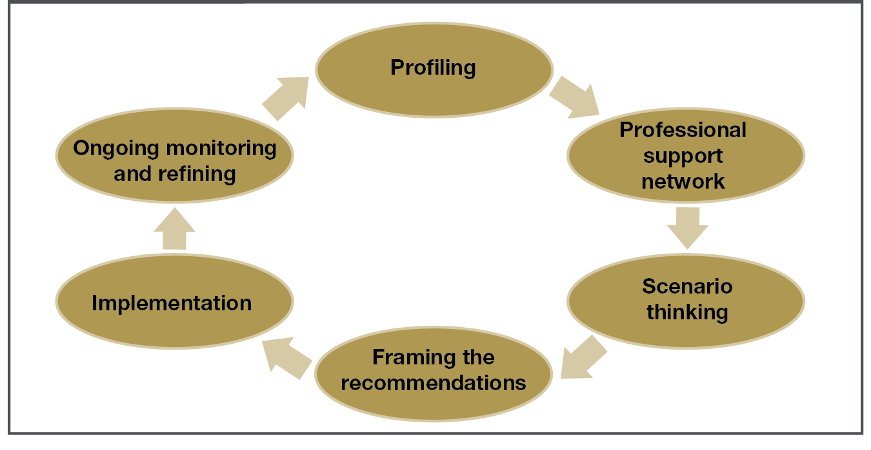
The Virtuous Cycle

Slide 9
Profiling
Cornerstone of the virtuous cycle.
The human element is foundational.
Ongoing.

Slide 10
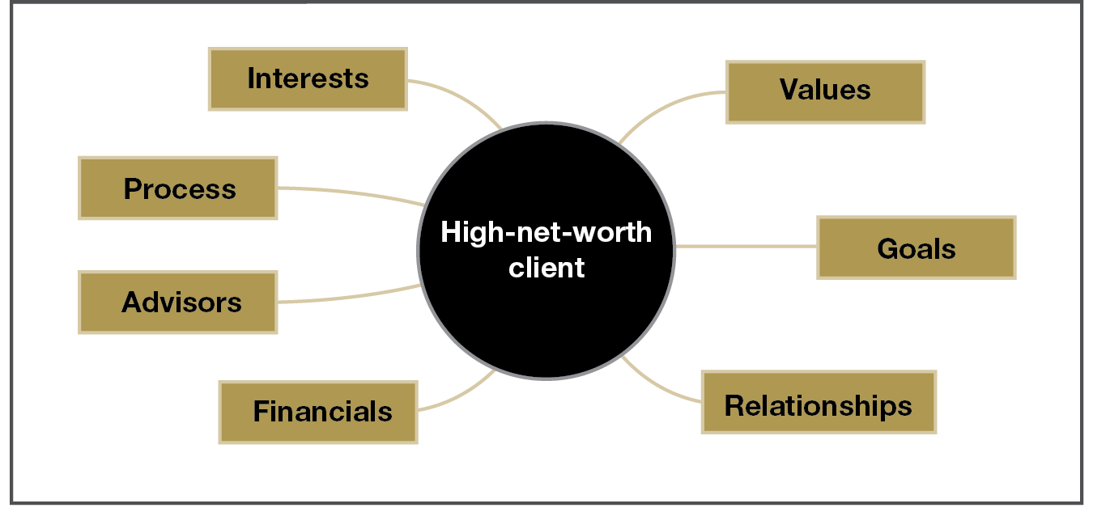
The Total Client Model

Slide 11
The Professional Support Network
Integrity
    Always the top criterion
Specialized expertise
    Top-of-the-line expertise
Professionalism
    Incredible responsiveness
Personal chemistry
    A well-oiled machine

Slide 12
Scenario Thinking
“What if my family members—they don’t get along too well— decide to start World War III after I’m gone?”
“What if I want to leave money to my lover, but I don’t want my spouse of children to know?”
“What if I want to pay the lowest possible taxes on my investments without having to give up how the money is managed?”

Slide 13
Framing the Recommendations
Explaining the possible solutions in a way that makes sense.
  Not only a discussion of the mechanics.
  Why these possible solutions are most appropriate.
Make sure you understand what you’re agreeing to.

Slide 14
Implementation
Regularly fairly straightforward.
All the hurdles have been identified, as well as the approaches to surmounting them.

Slide 15
Ongoing Monitoring and Refining
Ongoing monitoring
  Responding to innovations
  You drive reconnecting
  Your elite wealth planner drives reconnecting
  Periodic reviews
“Life is a perpetual movie, not a photograph.”
–Billionaire client

Slide 16
The Children

Slide 17
The Bad and the Good
The Bad
  The kid and the gold digger
  The bad seed and the family business
The Good
  Fostering entrepreneurship
  Facilitating philanthropy

Slide 18
The Bad
The kid and the gold digger: Love is forever, until it’s not.
  Prenuptial agreements
  Family trusts
The bad seed and the family business.
  “He’s just going through a phase.”
  “She didn’t mean what she said.”
  “All he needs is a little more growing up.”

Slide 19
The Good
Fostering entrepreneurship: the family bank
  Like acquiring funding from a venture capital fund or commercial bank
  An entity that is customized the family
  Needs to be funded
Facilitating philanthropy: the family foundation
  The ability to convert caring into financial and related support
  for worthy causes
  A family legacy
  Potentially in perpetuity

Slide 20
Your Elite Wealth Planner

Slide 21
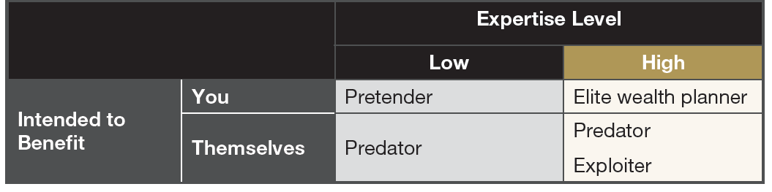
Types of Professionals

Slide 22
Finding an Elite Wealth Planner
Referrals from other professionals you’re working with
Referrals from peers, who are often part of a group of which you’re also members
Contacting a wealth planner because of his or her industry status – a thought leader

Slide 23
Four Core Selection Criteria
Criterion #1: Proven integrity
Criterion #2: A sense of purpose and deep concern for his or her clients
Criterion #3: Operational transparency
Criterion #4: Extensive technical expertise

Slide 24
Trust—but verify.
Stress Test

Slide 25
Super Rich Rationale for Stress Testing
Stress testing
Avoid potentially
destructive situations
Ensure benefitting
from all
possible opportunities

Slide 26
Comparing the Super Rich and
Less Wealthy Families
Super Rich
Low
Frequency of
errors or
opportunities
Less wealthy families
High
Low
High
Severity of errors or
opportunities

Slide 27
Stress Testing
Determine your goals
Evaluate existing or proposed services and products
Work the assumptions
Evaluate alignment with goals
Calculate cost structure
Address alternative services and products
Recommend course of action

Slide 28
The Need for Stress Testing
Wealth plans are dated; circumstances have changed.
  The level and structure of the family’s assets
  Changes in family and other relationships
Wealth planning was done incrementally.
  A piecemeal process
  Lack or synergy
  Opportunities for cost reductions
Wealth planning is not as good as it could be.
  Pretenders and Exploiters
  Availability of superior solutions
  Too focused on technical wizardry and not the human element

Slide 29
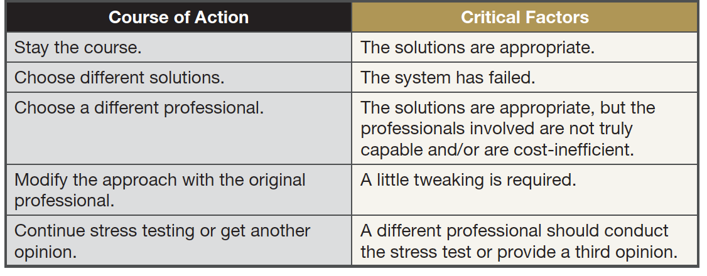
Courses of Action

Slide 30
Common Errors Found When Stress Testing
Income mitigation strategies were not considered.
Estate plans do not provide for heirs as desired.
Excessive amounts or poorly structured life insurance.
Personal umbrella policies are inadequate.
Family wealth could easily be lost when children divorce.
Inheritors are likely to go to war.
Asset protection plans have deadly “backdoors.”
Charitable monies can easily be redirected.

Slide 31
When you’re not 100 percent sure …
Implement stress testing to assess your wealth planning efficacy in different scenarios and at delivering the
results you expect.

Slide 32
Elite Wealth Planning
It’s all about you!
It’s about getting the outcomes you want.
  Taking care of loved ones
  Helping causes that are important to you
  Increasing your wealth
  Protecting your wealth
Requirement: Working with an elite wealth planner.

